Slide 1

BIRD SPECIES CLASSIFICATION
BIRD SPECIES
CLASSIFICATION

Slide 2

PRESENTED BY:
RITESHNU GHOSH (Roll: 16900116062)
PRITHWISH SARKAR (Roll: 16900116072)
SAYAN SARKAR (Roll: 16900116047)
SHASHI PRAKASH SHAH (Roll: 16900116046)
SRIJON REJ (Roll: 16900116029)

Slide 3

TABLE OF CONTENTS
Objective
How the classification is done
What is the main concept used
What is CNN
Algorithms used
What is RESNET
What is VGG16
Proposed model
Steps involved
The dataset
A snippet of the dataset
Preprocessing (Augmentation)
Feature Extraction
Classifier (Full Connection)
Steps involved
Fully Connected Layer
Softmax & Cross Entropy
How the model works
Final Results
Conclusion

Slide 4
OBJECTIVE
Classifying birds on the basis of their species from images.
Development of Convolutional Neural Network(CNN) model.
Analysis of classification algorithms.
Development of application which will help ornithologists to recognize birds with less effort.

Slide 5
HOW THE CLASSIFICATION IS DONE ?
Based on images .
WHAT IS THE MAIN CONCEPT USED ?
CNN or Convolutional Neural Network.

Slide 6
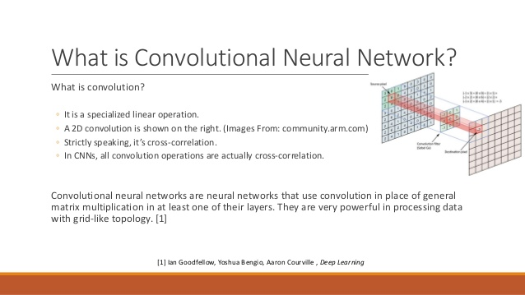
WHAT IS CNN?

Slide 7
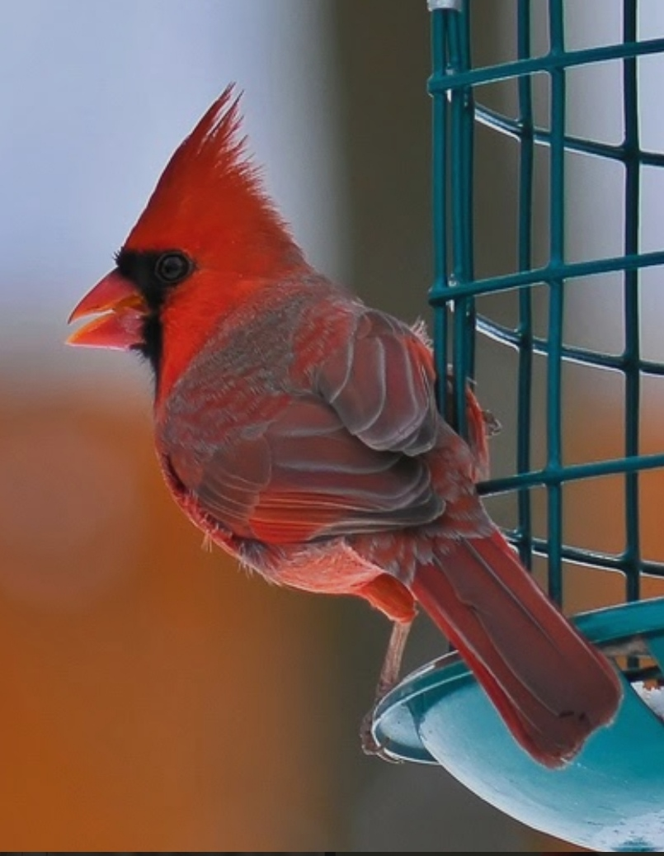
ALGORITHMS USED
For Dataset with IMAGENET WEIGHTS :
RESNET
VGG16
For Dataset without WEIGHTS :
VGG16
Convnet-I

Slide 8
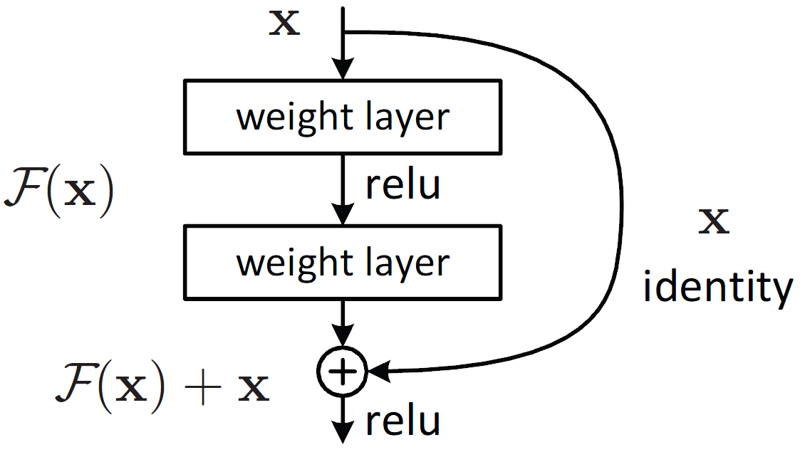
WHAT IS RESNET ?
Artificial Neural Network.
Constructed based on pyramidal cells of cerebral cortex.
Utilizes skip connections, or shortcuts to jump over some layers.
Implemented with double or triple layered skips that contain nonlinearities.

Slide 9
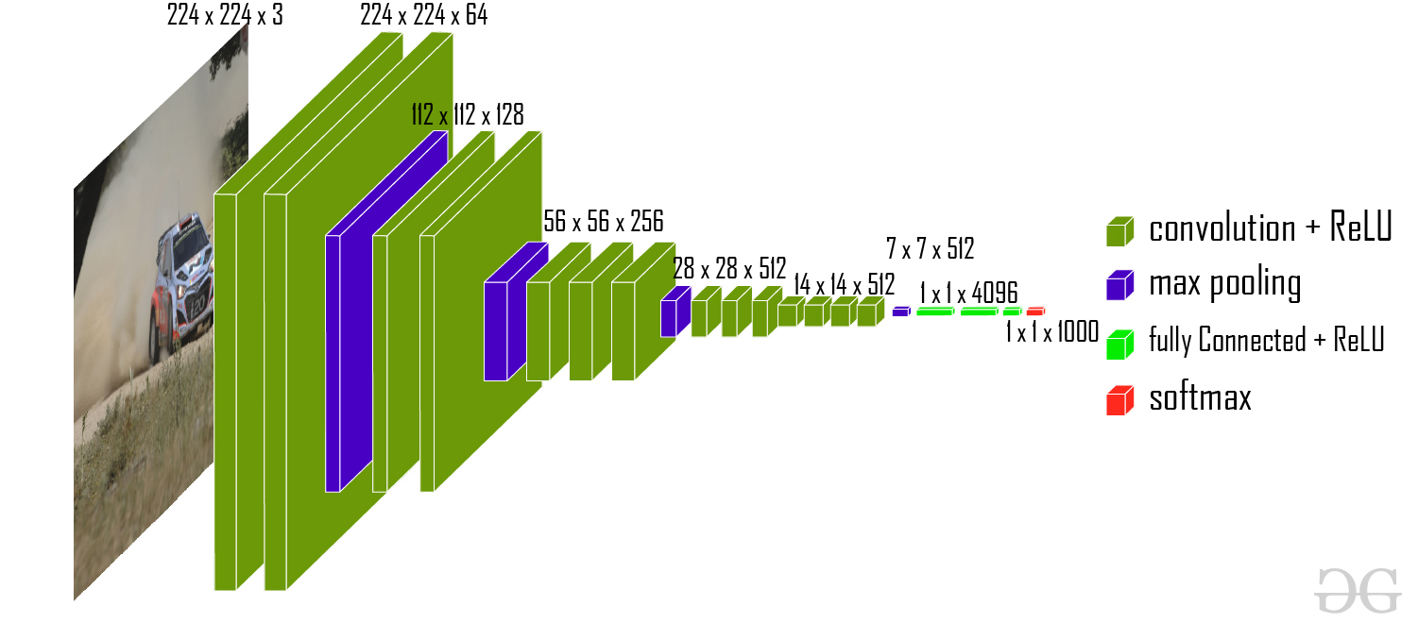
WHAT IS VGG16 ?

Slide 10
WHAT IS VGG16 ? (Continued…)
It's a Convolutional Neural Network.
Achieves 92.7% top-5 test accuracy in ImageNet.
Makes improvement over AlexNet.
Replaced large kernel-sized filters with multiple 3*3 kernel-sized filters one after another.

Slide 11
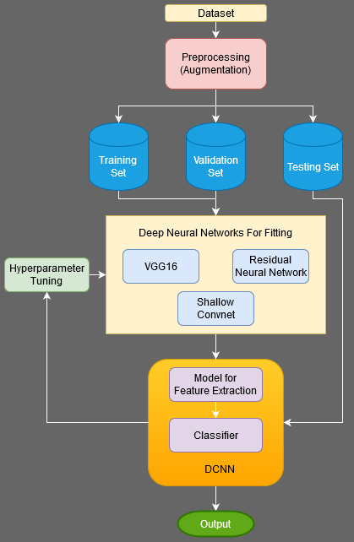
PROPOSED MODEL

Slide 12
STEPS INVOLVED…
BASICALLY FOUR STEPS ARE THERE :
Data Collection and Pre-processing
Feature Extraction and Training
Prediction
Analysis.
1
2
3
4

Slide 13
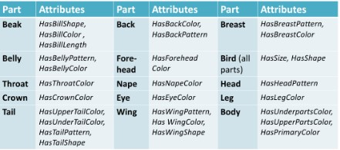
THE DATASET
We have used 20 birds Species from the Caltech-USCD BIRDS 200 [ CUB – 200-2011] as our main dataset.
FEATURES :

Slide 14
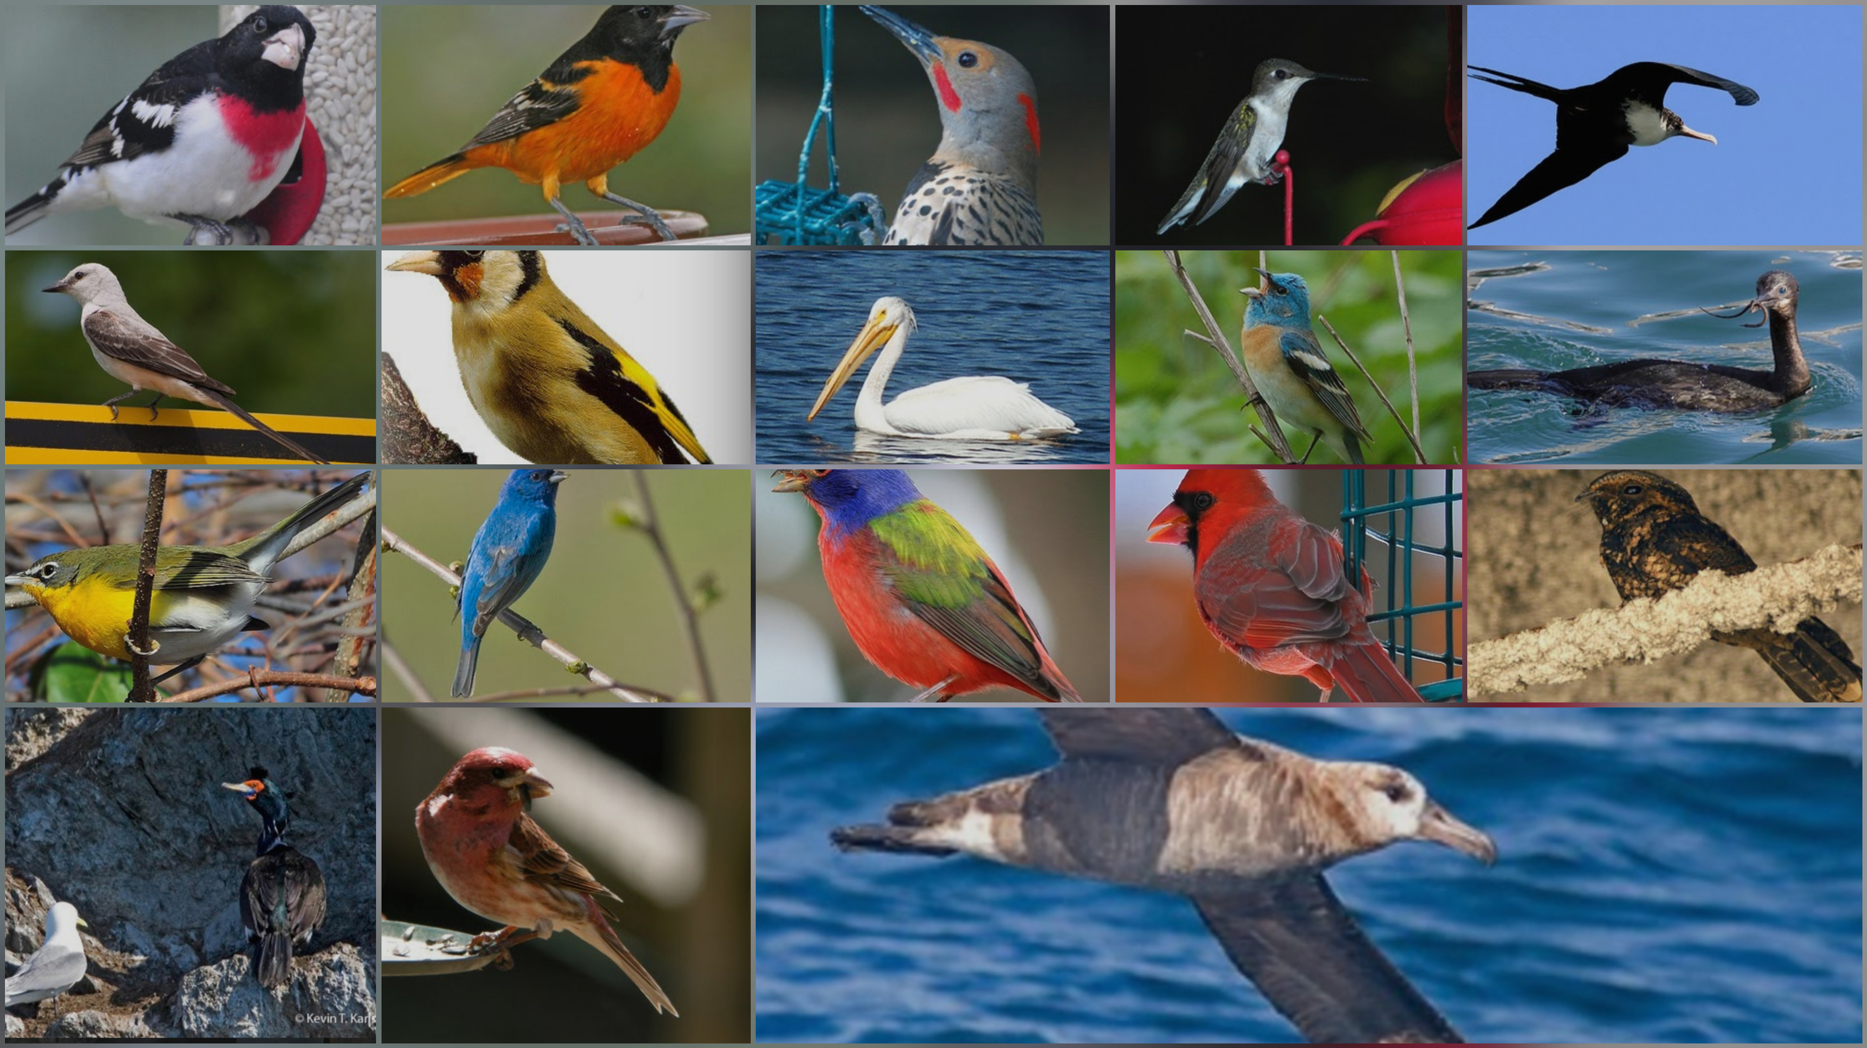
A SNIPPET OF THE DATASET

Slide 15
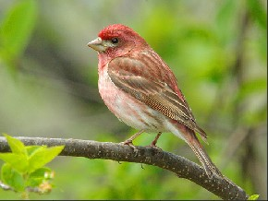
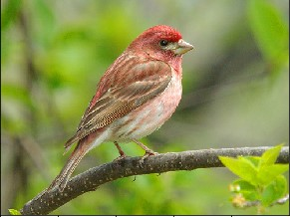
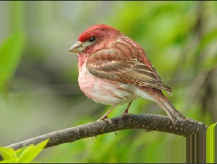
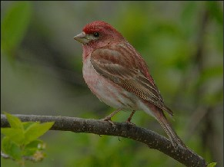
PREPROCESSING (AUGMENTATION)
Rotation
Brightness
Shear

Slide 16
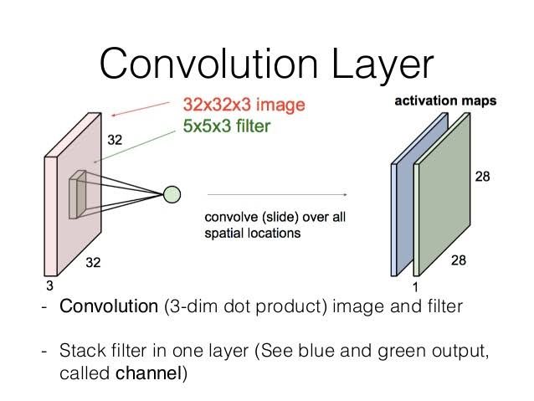
FEATURE EXTRACTION
CONVOLUTION LAYER :
Identify features.
Generate feature maps.
Use filters as sliding windows
Use padding to preserve spatial
dimension.

Slide 17
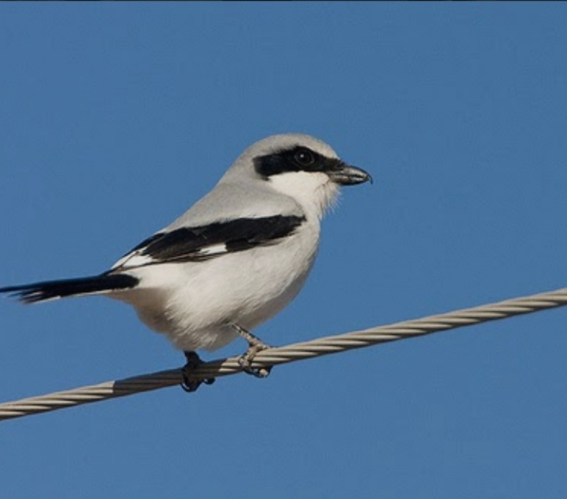
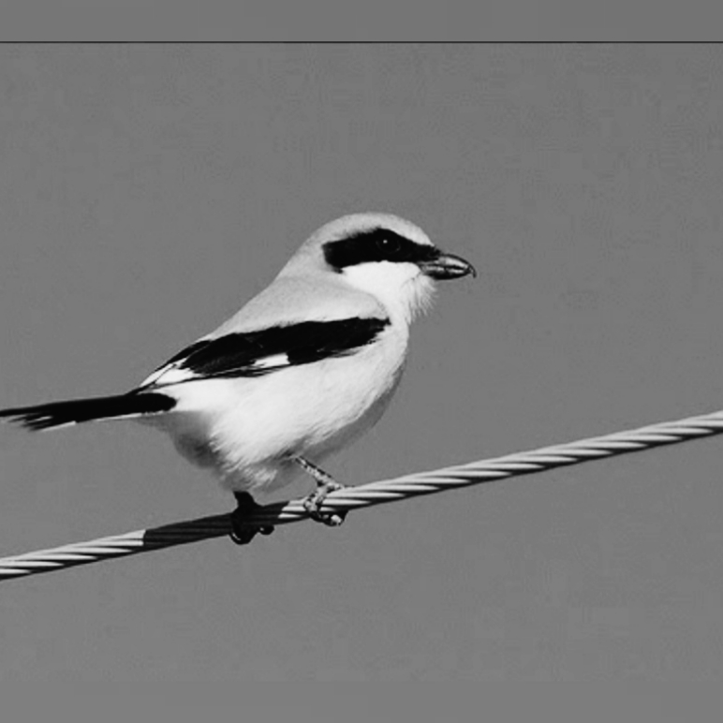
FEATURE EXTRACTION (Continued…)
1 | 1 | 1 | 1 | 1 | 1
1 | 1 | 1 | 1 | 1 | 1
1 | 1 | 1 | 1 | 1 | 1
1 | 1 | 1 | 1 | 1 | 1
1 | 0 | 1 | 0 | 1 | 1
0 | 1 | 0 | 0 | 2 | 1
1 | 1 | 1 | 0 | 1 | 1
1 | 0 | 1 | 1 | 1 | 1

Slide 18
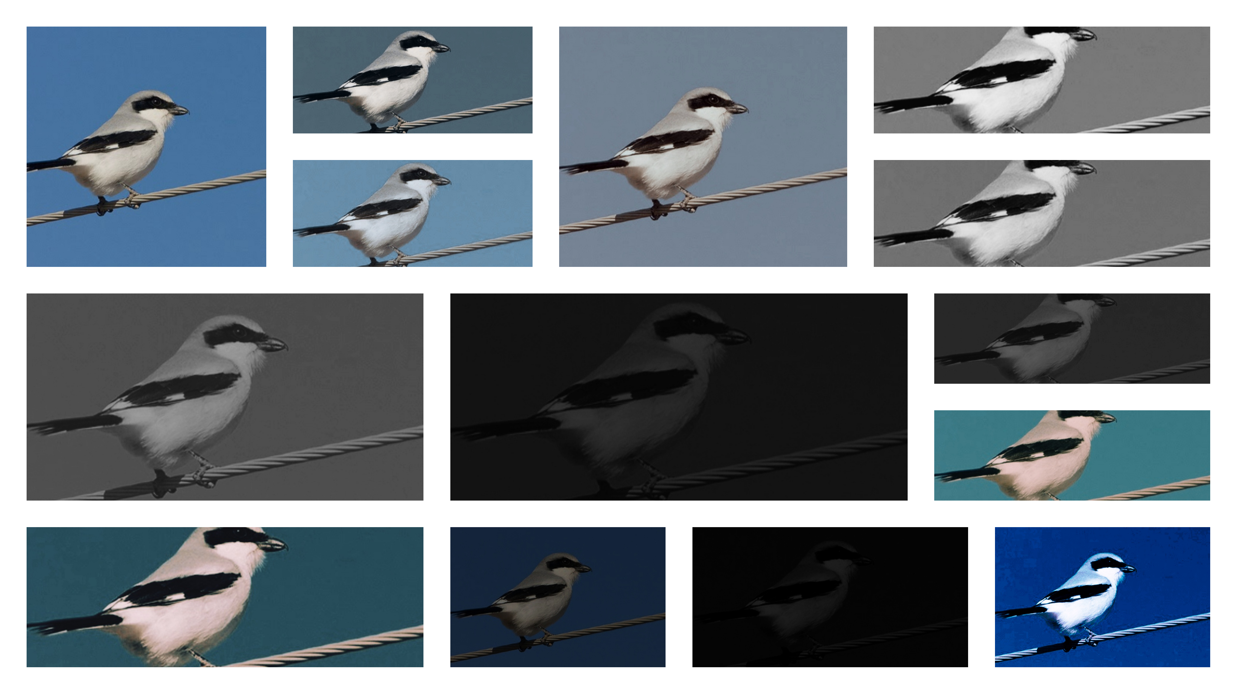
DIFFERENT FEATURE MAPS

Slide 19

FEATURE EXTRACTION (Continued…)
NORMALIZATION LAYER (ReLU) :
Stands for Rectifier Linear Unit.
ReLU helps with the vanishing gradient problem.
Increases non-linearity in our image.
Uses Activation Function.

Slide 20
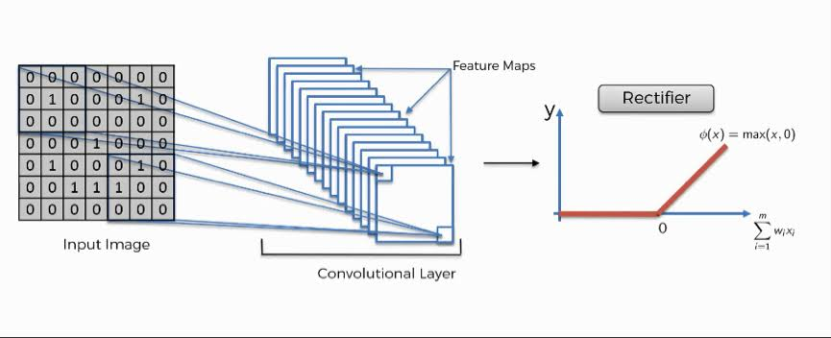
FEATURE EXTRACTION (Continued…)

Slide 21
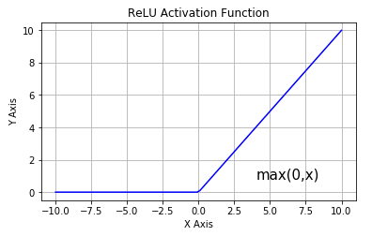
FEATURE EXTRACTION (Continued…)

Slide 22
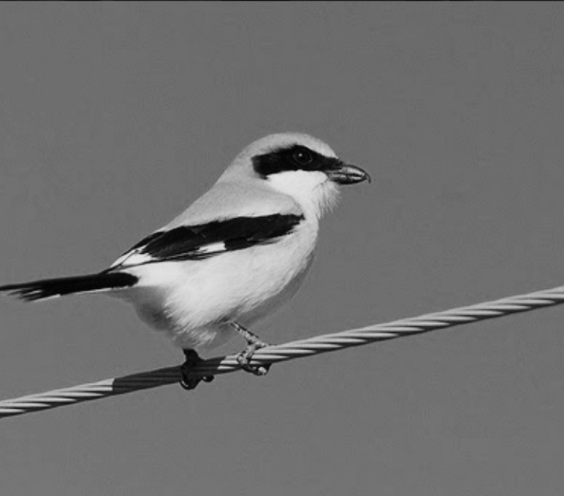
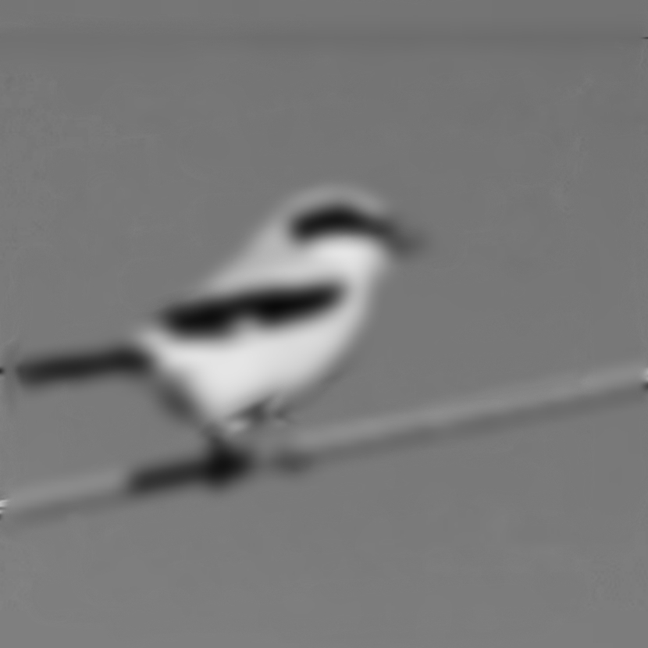
FEATURE EXTRACTION (Continued…)
How it works :
After applying rectifier

Slide 23
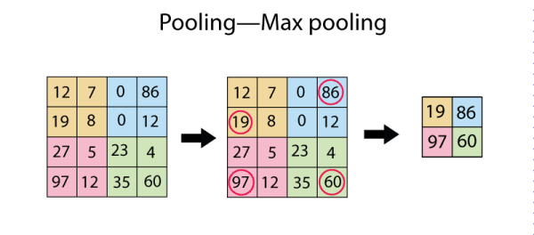
FEATURE EXTRACTION (Continued…)
POOLING :
Generally Max Pooling is used.
Use to capture useful information in small subset of pixels.
Reduces Spatial dimensions of previous
3D feature map input.
Extract maximum of average of a region.

Slide 24
FEATURE EXTRACTION (Continued…)
Choosing the maximum value from each feature grid :
1 | 0 | 1 | 0 | 1 | 1
0 | 1 | 0 | 0 | 2 | 1
1 | 1 | 1 | 0 | 1 | 1
1 | 0 | 1 | 1 | 1 | 1
1 | 2
1 | 1

Slide 25
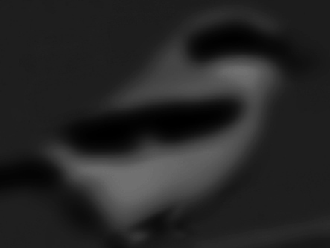
FEATURE EXTRACTION (Continued…)
After Pooling

Slide 26
CLASSIFIER (FULL CONNECTION )

Slide 27
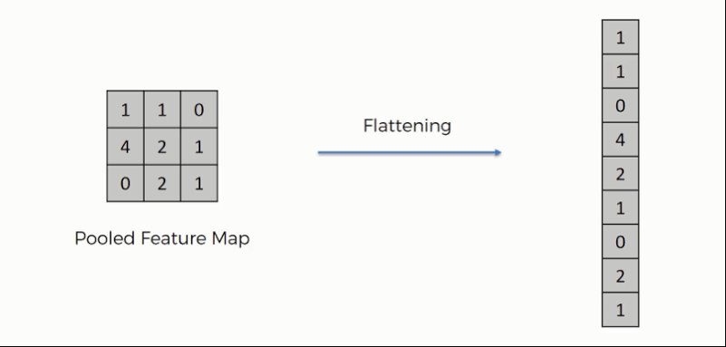
STEPS INVOLVED…
Flat feed-forward neural network layers are used as the first layer.
Have non-linear activation or softmax activation for prediction.
Use dropout during training to reduce overfitting
Finally, a score sheet is generated for classification.
1
2
3
4

Slide 28
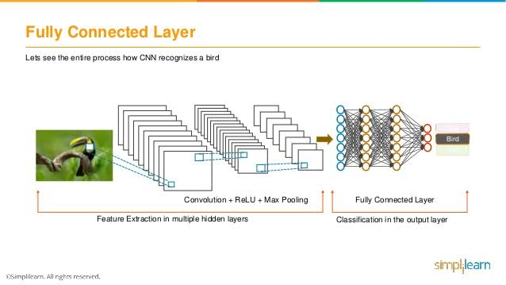

Slide 29
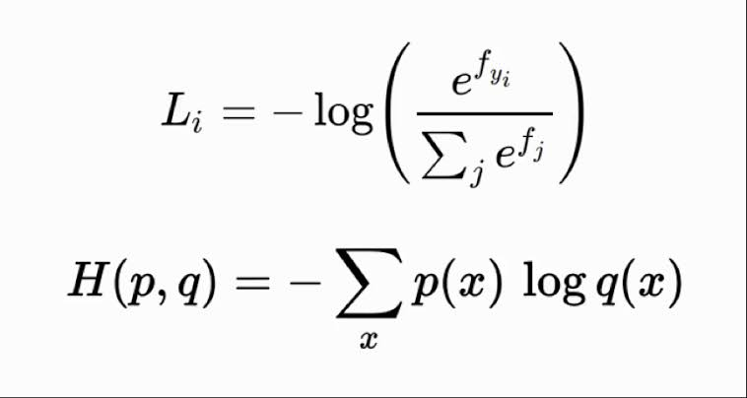
SOFTMAX & CROSS ENTROPY
Used for Accuracy.
Based on Probability.

Slide 30
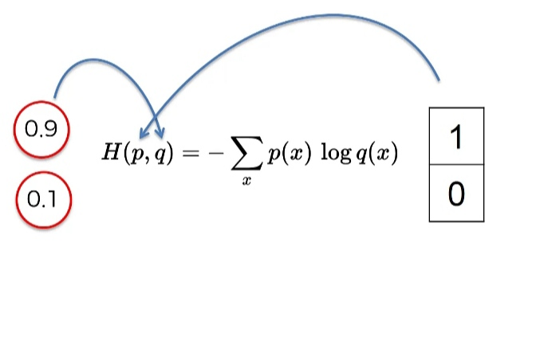
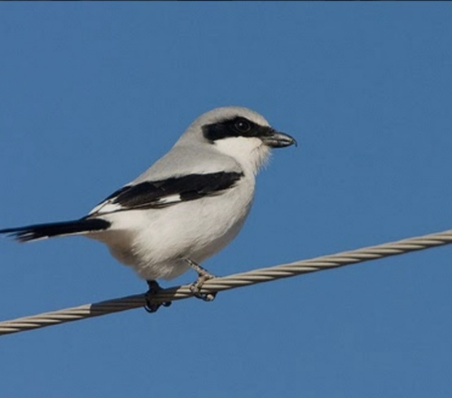
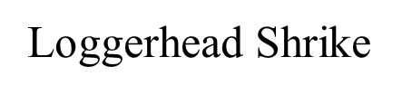
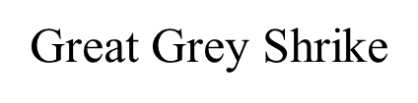
SOFTMAX & CROSS ENTROPY (Continued…)
0.6
0.4

Slide 31
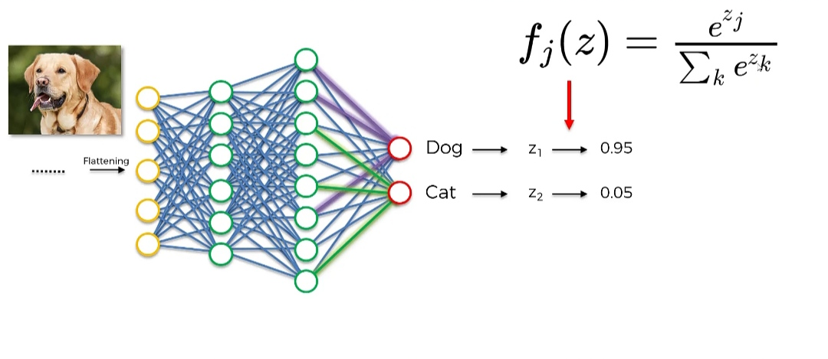

HOW THE MODEL WORKS
Loggerhead Shrike (z1)
0.6
Great Grey Shrike (z2)
0.4

Slide 32
FINAL RESULTS
Algorithms | Testing Accuracy (in %) | Training Accuracy (in %)
Convnet-1 | 52 | 85
VGG16 With ImageNet weight | 97 | 97
VGG16 Without ImageNet weight | 52 | 52
ResNet-50 With ImageNet weight | 52 | 32

Slide 33
CONCLUSION
The model is able to generate an accuracy of 85%.
The model is able to identify 20 different species of birds.
No. of hidden layers can be increased for the betterment of the result.

Slide 34



